Slide 1

Using the Mesonet Website
For Fun and/or Profit
Daryl Herzmann
@akrherz
26 August 2025
Website -> Info Tab -> Presentations

Slide 2
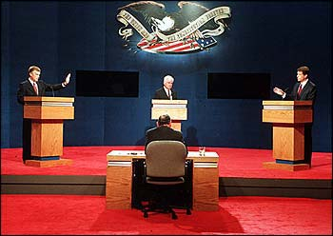
Who am I and Why am I here?
Hi I’m daryl! I’m staff in Agronomy with a BS in Meteorology.
I’m the proprietor of the IEM website.
All y’all are supposed to be directly in my wheelhouse for website users to support!
AP Photo

Slide 3

What is going on here? https://mesonet.agron.iastate.edu
For past 24 years, I’ve implemented about 95% of the requests made of me for weather / climate products + data.
Unmitigated website feature sprawl with ~150 apps, ~40 download portals, and ~260 automated plotting apps.
To atone for these sins, I promptly answer all the emails I get. (GOTO step 1)

Slide 4

Horrible Self Own.
So I need to spend an hour with a Powerpoint to explain how to use a website in the year 2025?

Slide 5
30,000 foot view of IEM
Other states have a University/State “Mesonet” with staff (gasp), deployed equipment, and research programs.
ISU has a “Soil Moisture Network”, which is a quasi mesonet, some call it the mesonet, but it is not what the IEM is!
Data from the Soil Moisture Network is found on the IEM website, along with everything else under the sun! To make things fun and confusing.

Slide 6

Augh daryl!
I just want to know how much it rained and if we are above or below average for GDDs.
Tenor.com

Slide 7

TELL ME RAINFALL AND GDDs!
Do you know what you are asking for?
What is average/normal, are they even the same?
What are your accuracy requirements?
What variability are you attempting to explain?
Tenor.com
Speaking of Variability….

Slide 8
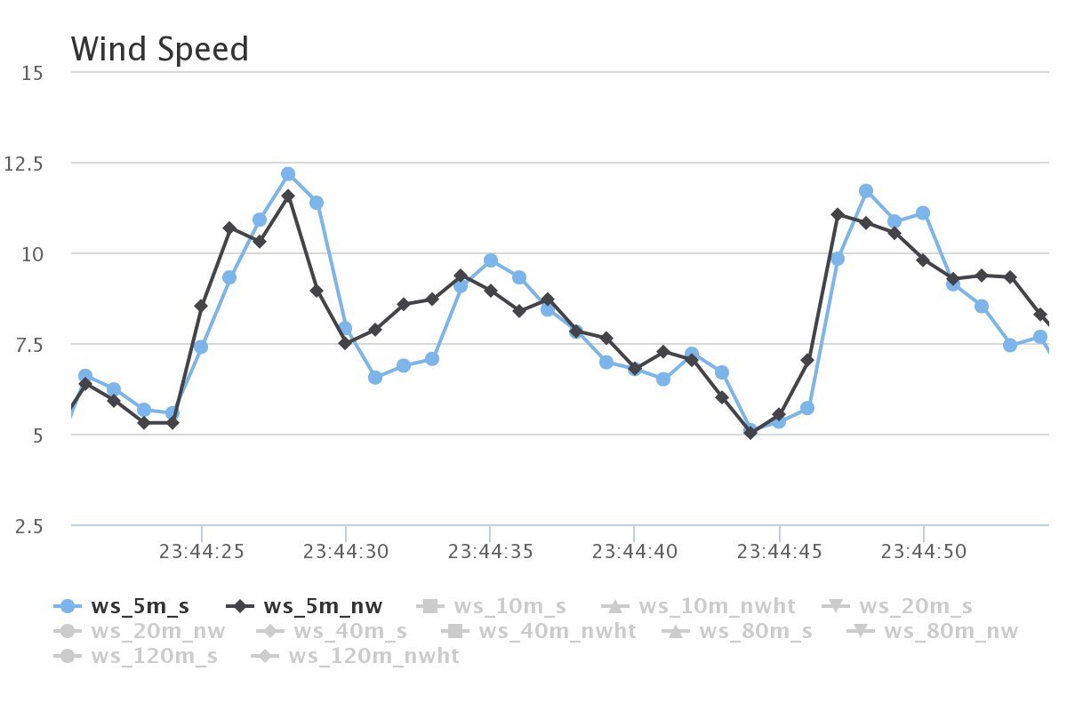
ISU “Tall Towers” 1 second interval Wind Speed [mps]
This entire plot is just 1 minute of data!
Two sensors at same height, mounted at different directions on the tower. We also have 20 Hz data ☺

Slide 9
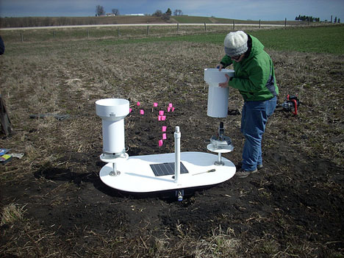
Precipitation Variability
Iowa Flood Center experiment with tipping buckets 3 feet apart
Found some cases of noticeable differences between these two gauges
In general case, which gauge is right? ☺
http://iowafloodcenter.org/notes-from-the-field-rain-gauges/

Slide 10
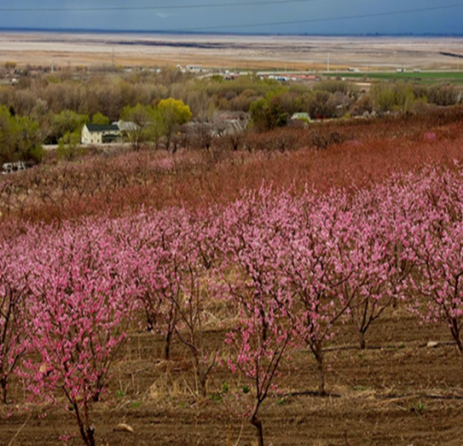
Temperature Variability
Subtle topography / elevation changes make a difference!
Similar to wind, one second plots sometimes show rapid temperature fluctuations
Urban Heat Islands impact temperature representativity
Photo: Dr Elywnn Taylor

Slide 11
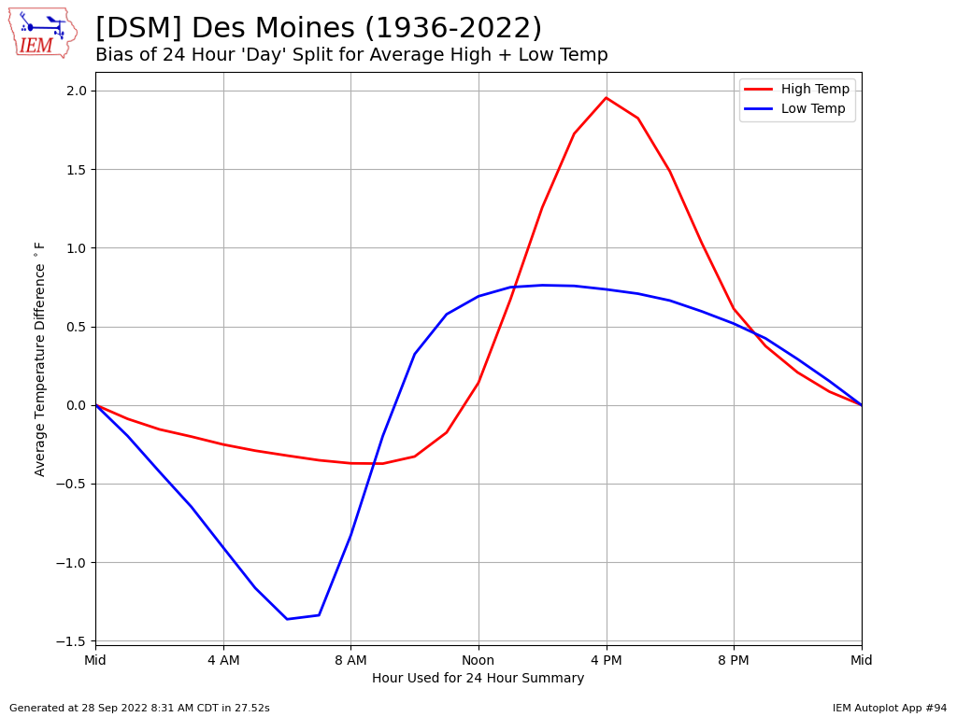
Web Link #94

Slide 12
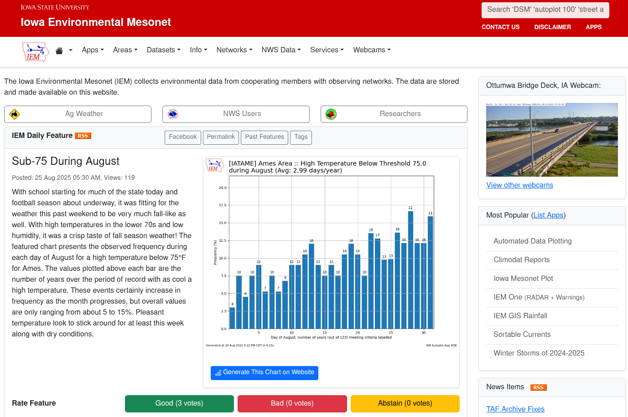

Slide 13
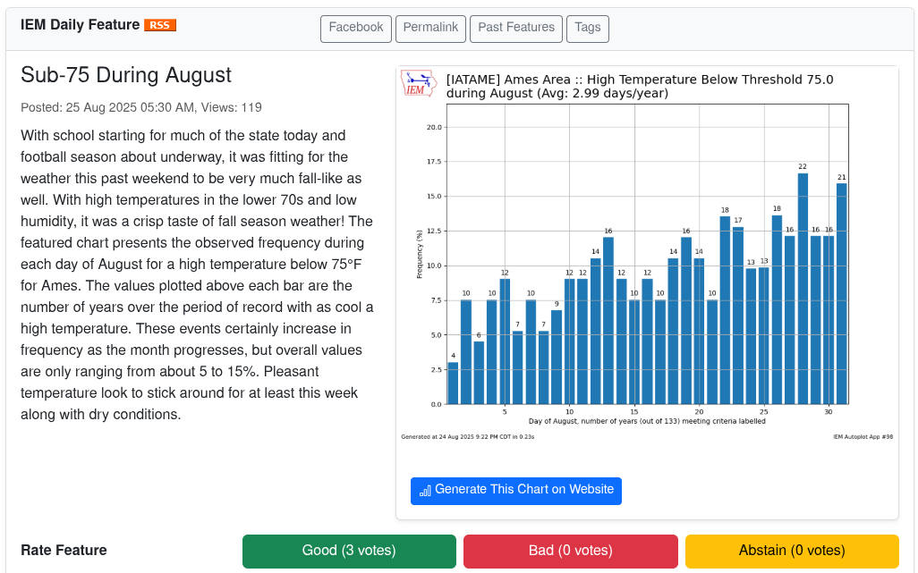
Plugging my IEM Daily Feature
Highlights something hopefully relevant each day
RSS Feed if you don’t want to check website daily, also view past features
Often links to IEM app that generated the plot, so you can tweak, download raw data

Slide 14
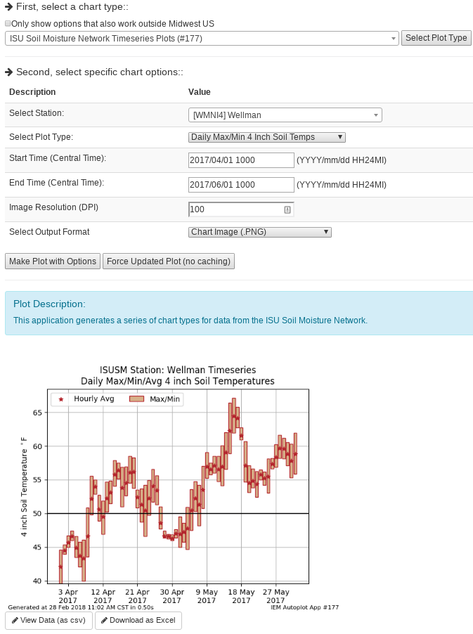
IEM Auto Plotting
Select Plot Type
Select Plot Options
Description
Custom Generated Plot
Download Raw Data (Excel)

Slide 15
Which network should I use?
Data Need | Recommendation
“Daily” High/Low Temps + Precipitation | NWS COOP IEM “Long Term Climate” / “Climodat”
Wind | ISU Soil Moisture ASOS / AWOS (Airport weather stations)
Solar Radiation | ISU Soil Moisture
Hourly Rainfall, not snow | ISU Soil Moisture / ASOS / AWOS
River Stage | DCP (USGS gauges)
Soil Temperature/Moisture | ISU Soil Moisture / SCAN
Humidity | ISU Soil Moisture / ASOS / AWOS
Pavement Temperatures | RWIS

Slide 16
Some Weather Variables to Monitor
Growing Degree Days
Temperatures
Soil Moisture/Temperature
Precipitation
Wind

Slide 17
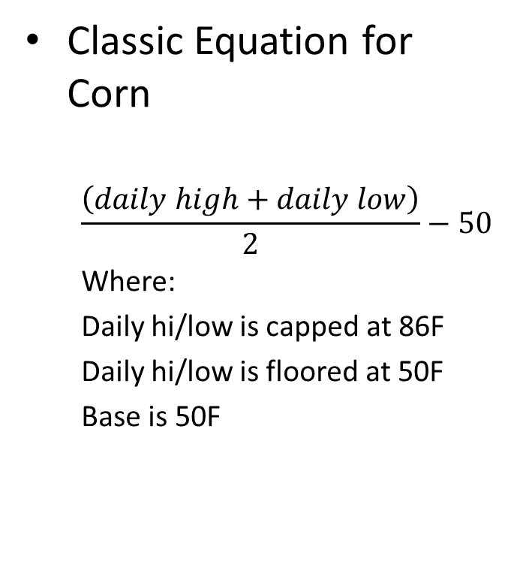
What are Growing Degree Days (GDD)?
Classic Equation for Corn
  $$\frac{\left(daily high+daily low\right)}{2}−50$$
  Where:
  Daily hi/low is capped at 86F
  Daily hi/low is floored at 50F
  Base is 50F
Example 1
High 90
Low 48
GDD: (90 86 + 48 50)/2 – 50 = 18
Example 2
High 40
Low 32
GDD: (40 50 + 32 50)/2 – 50 = 0

Slide 18
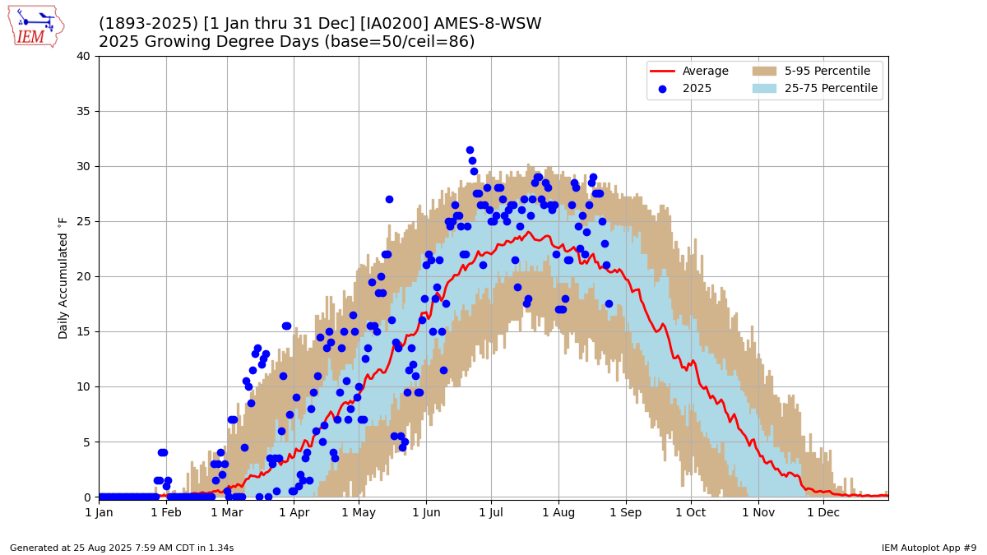
Web Link #9

Slide 19
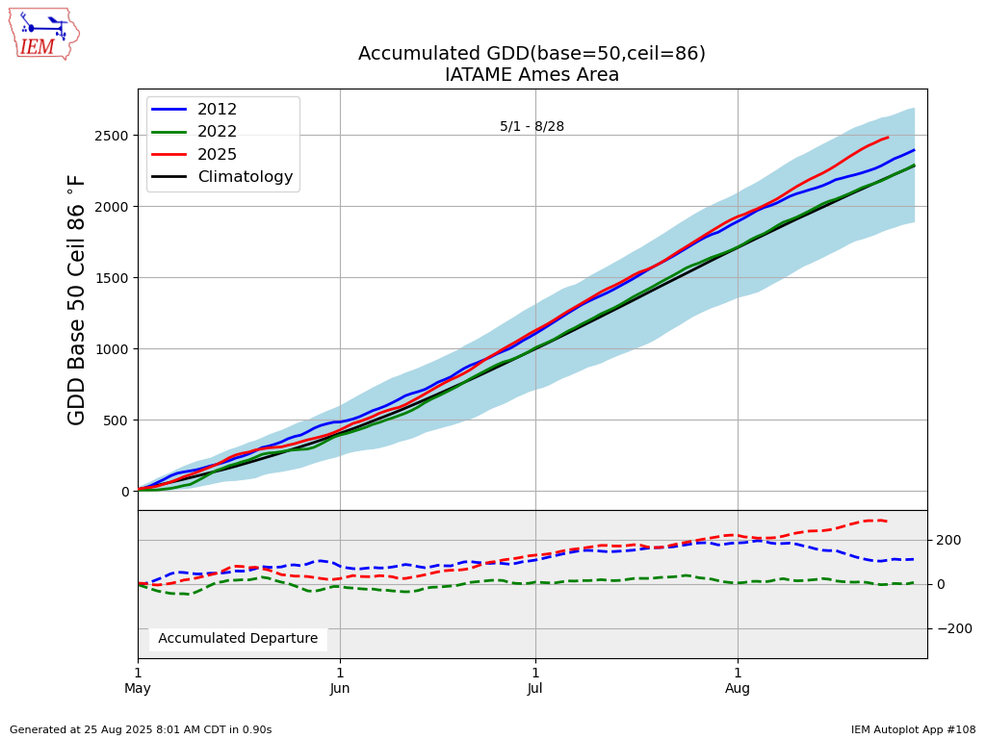
Web Link #108

Slide 20
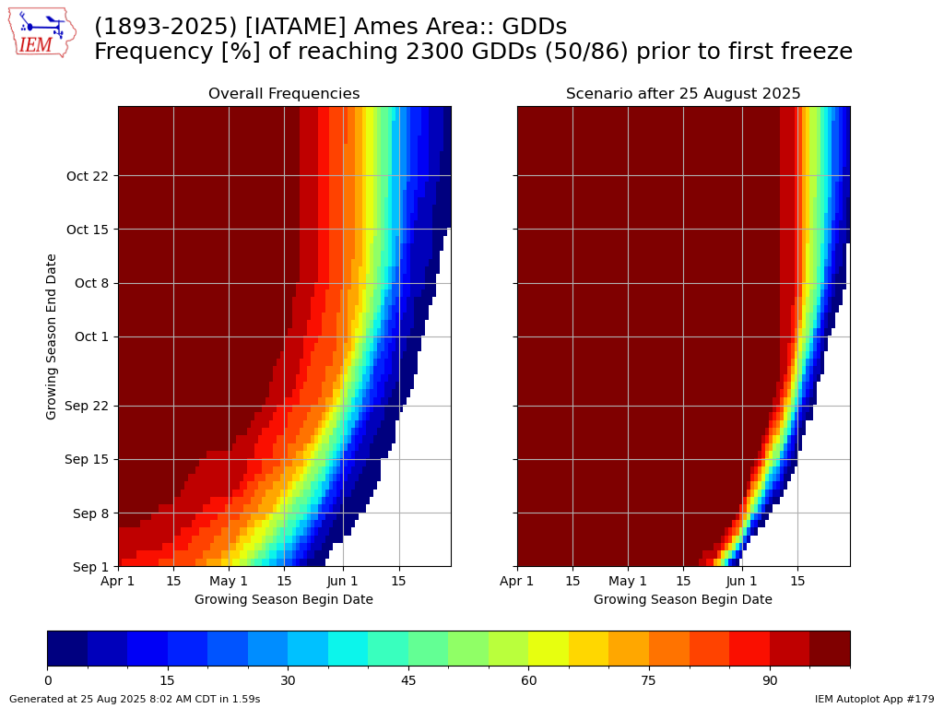
Web Link #179

Slide 21
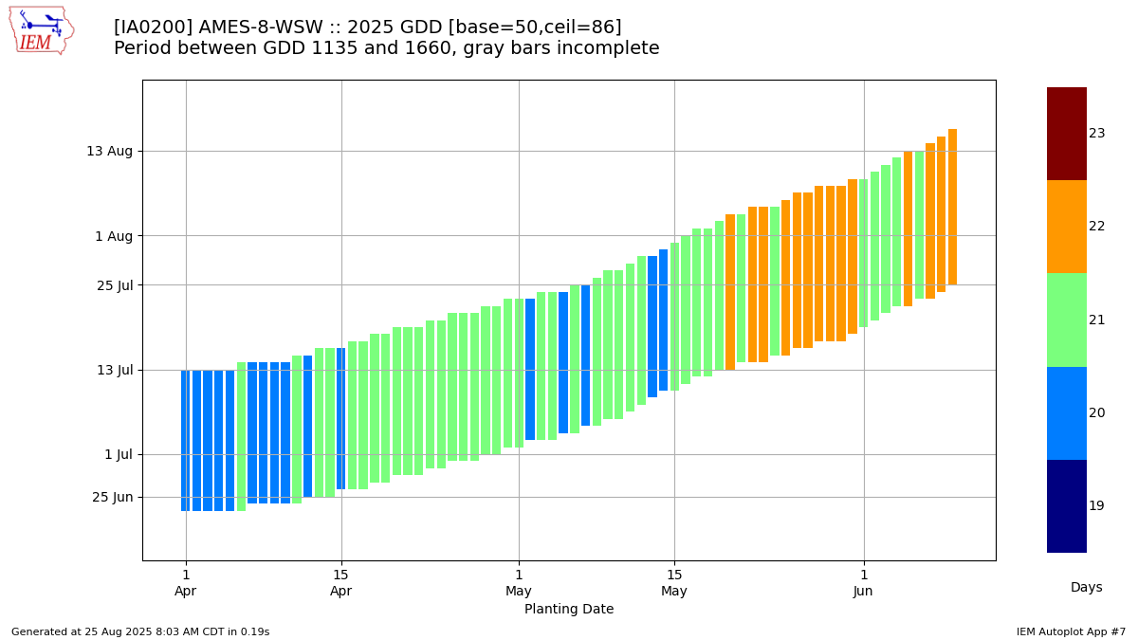
Web Link #7

Slide 22
Some Weather Variables to Monitor
Growing Degree Days
Temperatures
Soil Moisture/Temperature
Precipitation
Wind

Slide 23
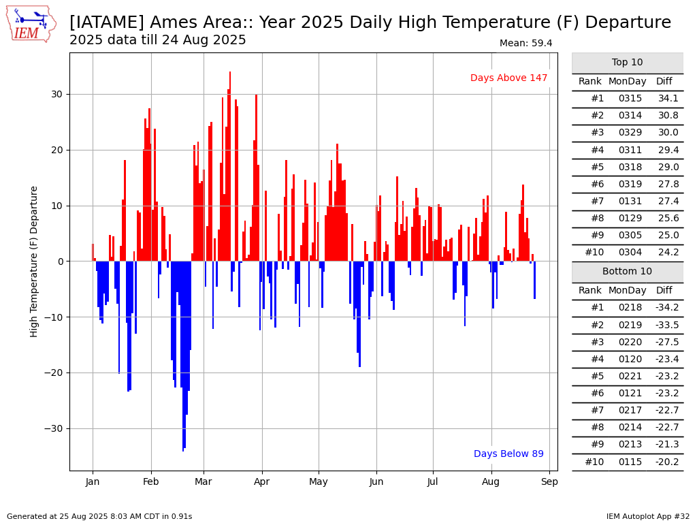
Web Link #32

Slide 24
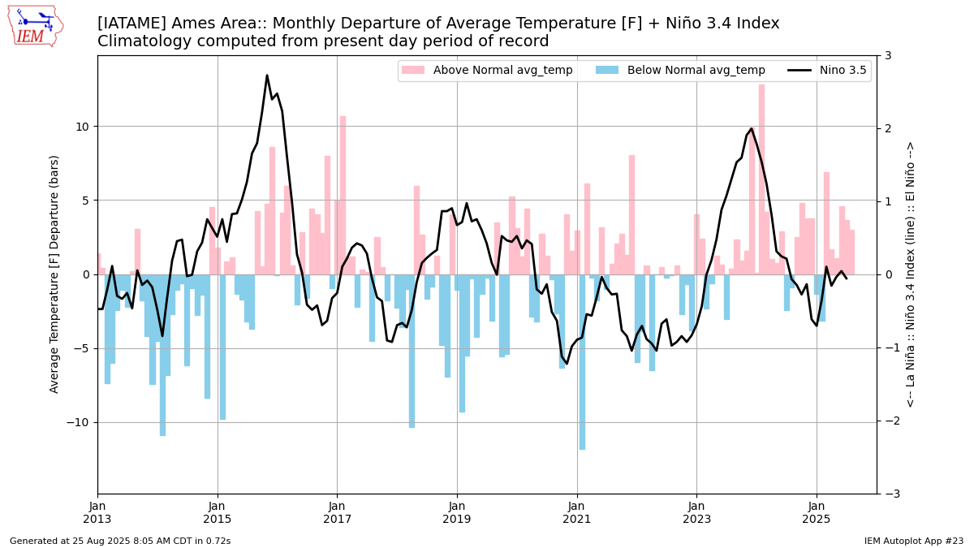
Web Link #23

Slide 25
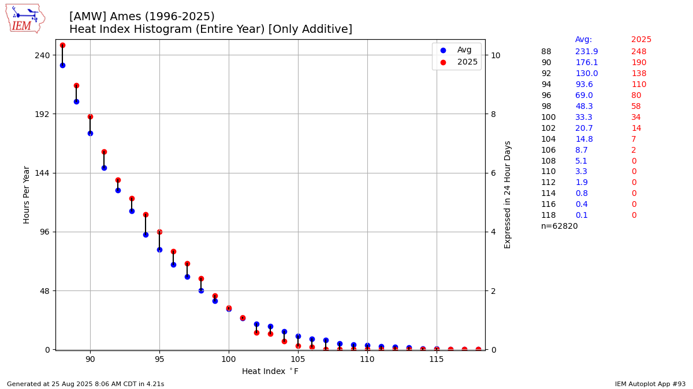
Web Link #93

Slide 26
Some Weather Variables to Monitor
Growing Degree Days
Temperatures
Soil Moisture/Temperature
Precipitation
Wind

Slide 27
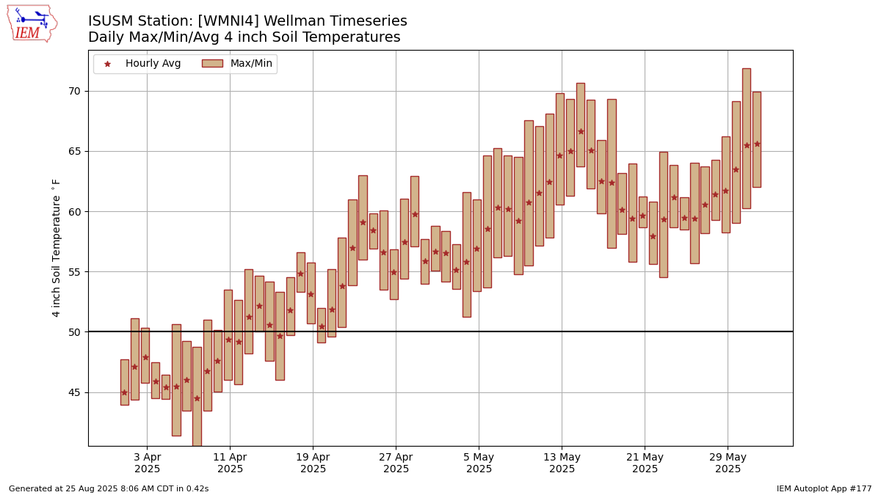
Web Link #177

Slide 28
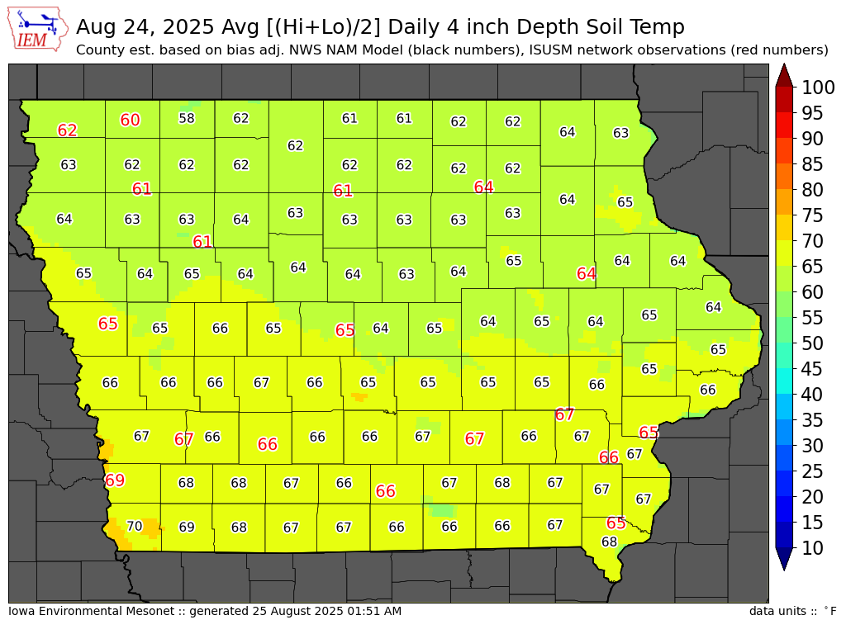
Web Link

Slide 29
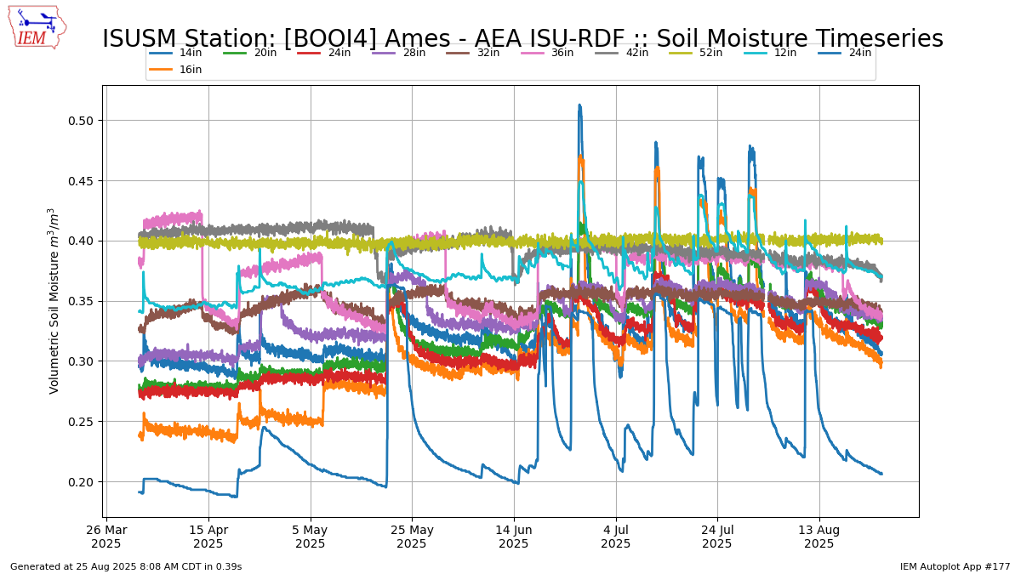
Web Link #177

Slide 30
Some Weather Variables to Monitor
Growing Degree Days
Temperatures
Soil Moisture/Temperature
Precipitation
Wind

Slide 31
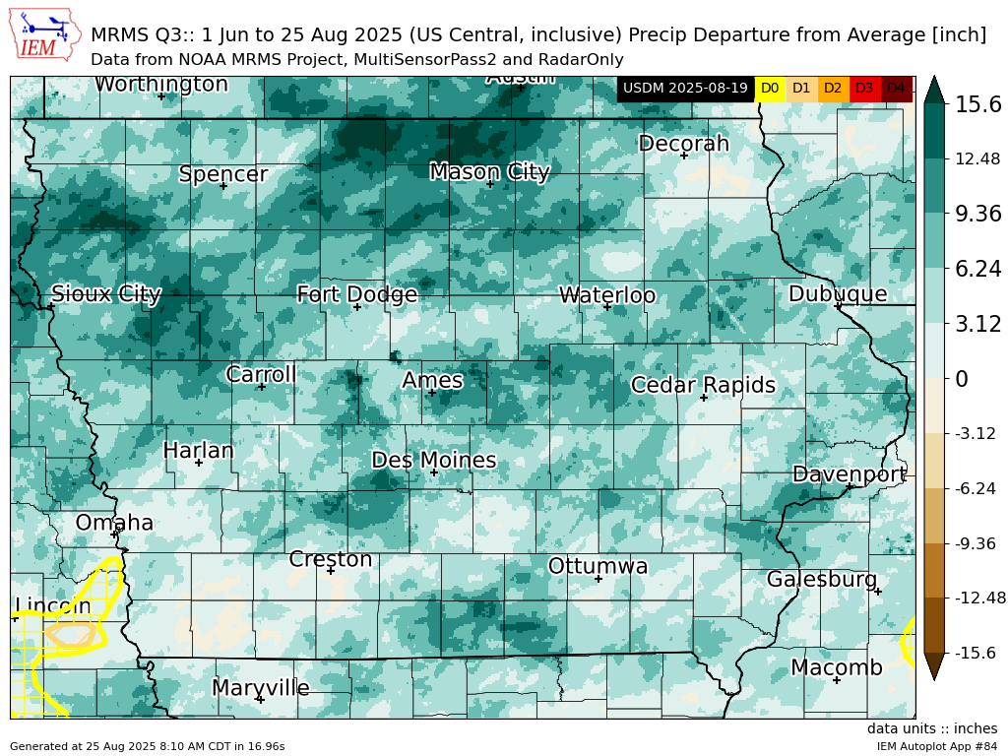
Web Link #84

Slide 32
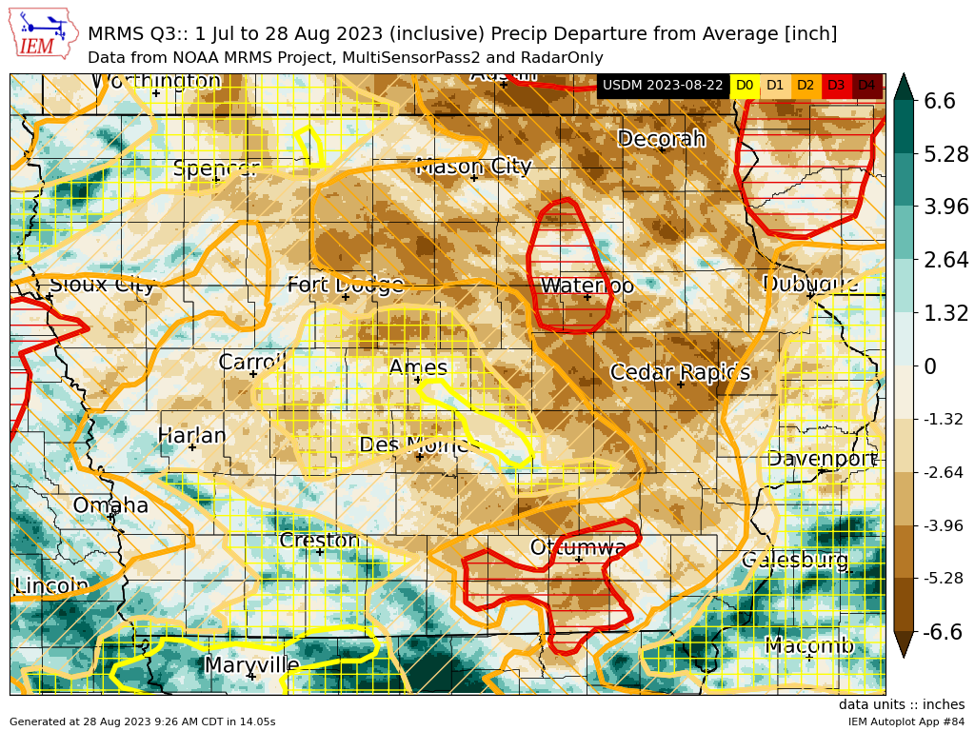
Web Link #84

Slide 33
Some Weather Variables to Monitor
Growing Degree Days
Temperatures
Soil Moisture/Temperature
Precipitation
Wind

Slide 34
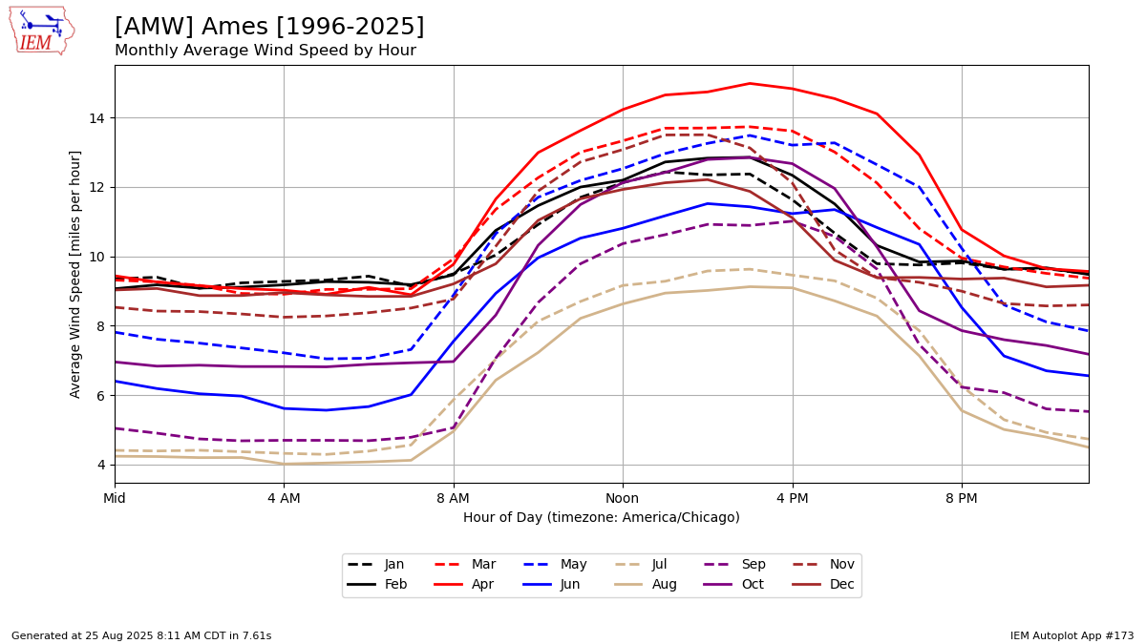
Web Link #173

Slide 35
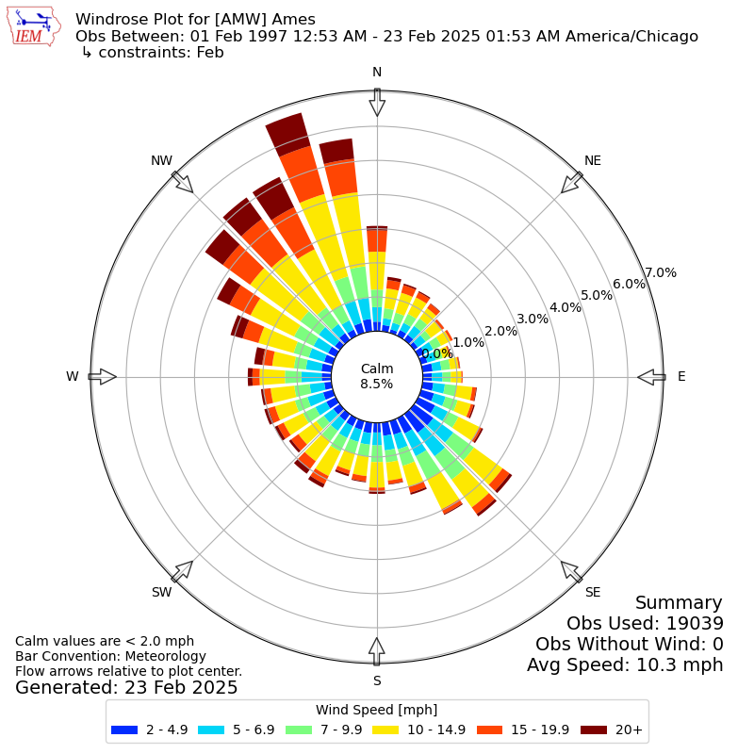
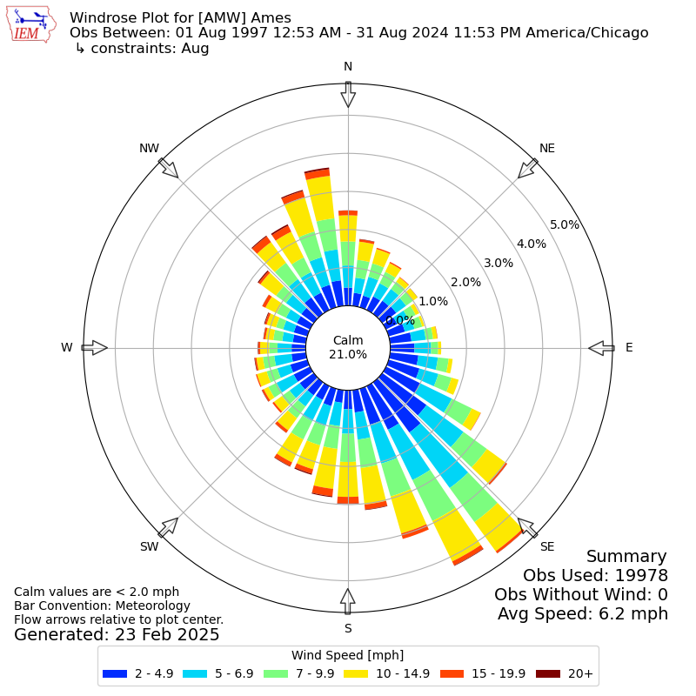
February vs August Wind Rose
Web Link

Slide 36
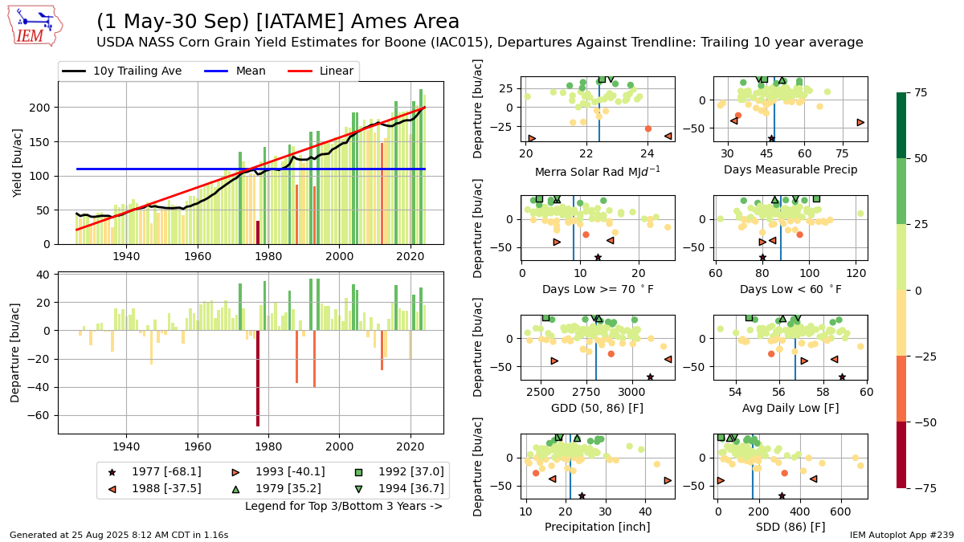
Putting it all Together
Link

Slide 37
Task 1: Using IEM Explorer
For your location
  Find nearest long term climate site
  Find nearest airport weather station
Play around with various popular content links

Slide 38
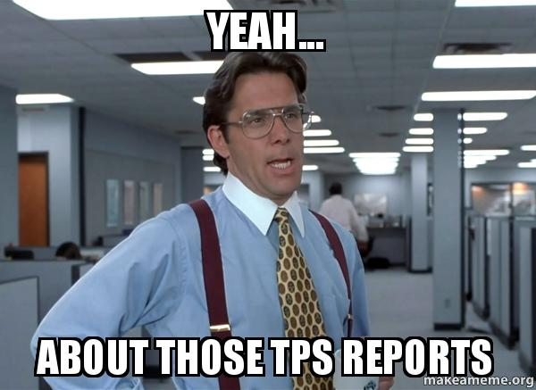
Task 2: TPS Reports
Temperature
Precipitation
Snow
Determine the July 2025 precipitation total and departure from average

Slide 39
Task 3: Growing Season Totals
Generate a map of 22 April to 22 August total precipitation for 2012 and 2025

Slide 40
Task 4: Soil Temperatures
Find a map of Iowa soil temperatures on 1 May 2025
Download the raw observations from the ISU Soil Moisture Network

Slide 41
Task 5: Solar Radiation
Download daily solar radiation estimates from NWS COOP sites for 2025 into Excel
Generate chart of daily observations from ISU Soil Moisture Network

Slide 42
Task 6: IEM Autoplot Chart
Find a chart of Nino 3.4 index and Iowa precipitation departures
Download the raw data from the chart into Excel for further analysis.

Slide 43
Task 7: NWS Warning Information
My mom’s farm took damage on 28 June 2017.
  Go find NWS Warning information and storm reports for the event
  Step through RADAR maps to see the timing of the storm

Slide 44
Task 8: Wind Roses
Generate a wind rose for the day of 14 June 2025
Check out the pre-generated monthly/annual climatology plots

Slide 45
Fun Task 1: Webcam Archive
How did things look during the blizzard of 4 February 2021 around noon?
Check out akrherz’s YouTube Channel for fancy loops.

Slide 46
Fun Task 2: High-Res Precipitation Maps
Create a fine scale map of precipitation estimates for 27 August 2022 for Winneshiek County
For the same area, generate a map of departures between 1 July and 25 August 2025

Slide 47

OK, enough of my rambling…. Questions? https://mesonet.agron.iastate.edu
“Info” Tab -> Presentations
Twitter: @akrherz
akrherz@iastate.edu
515-451-9249

