Slide 1

IEM Dog and Pony Show
Daryl Herzmann
@akrherz
Iowa State University
Notes:
Here we go!

Slide 2
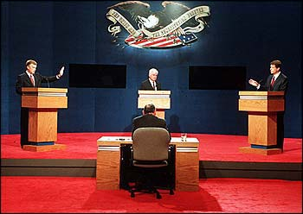
Who am I and why am I here?
2001 Meteor BS degree
Work for Iowa State University
Contractor with NWS
Co-Creator of NWSChat
I like free food (note: remove this before talk if no free food is present)
Photo: AP Images
Notes:
Admiral Stockdale wondered why he was at the vice president debate, so some wonder why I am here giving this talk. If the women do not find you handsome, they should at least find you handy.

Slide 3
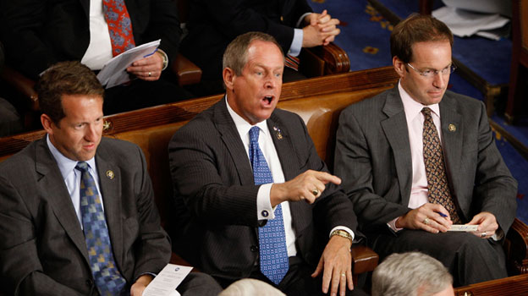
See something you don’t like?
Yell at me!
Photo: AP Images
Notes:
This guy interrupted the president, so surely you can interrupt me.

Slide 4
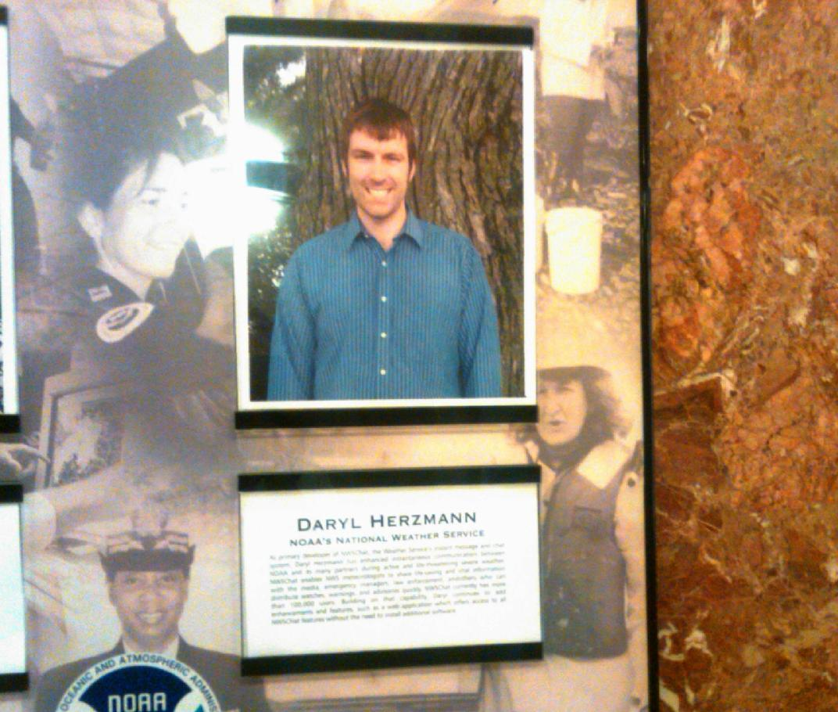
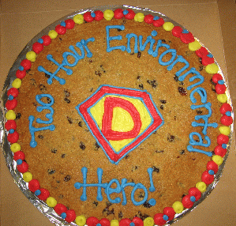
Diplomatic Immunity
June 2012 NOAA Team Member of the Month
2007 NOAA Environmental Hero
Notes:
I win awards, so I can complain about the people that give me awards.

Slide 5
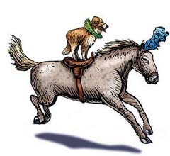
What’s a Dog and Pony Show?
Wikipedia - "Dog and pony show" is a colloquial term which has come to mean a highly promoted, often over-staged performance, presentation, or event designed to sway or convince opinion for political, or less often, commercial ends.
Photo: Blogspot.com
Notes:
Lots of show upcoming, buckle up.

Slide 6
What shall we discuss?
Converting Watches into Warnings
My standard ranting about storm based warnings
IEM archives and web tools that may help you out
  IEM Cow
  IEM Raccoon
Notes:
The next fifty minutes of your life will consist of this tedium

Slide 7
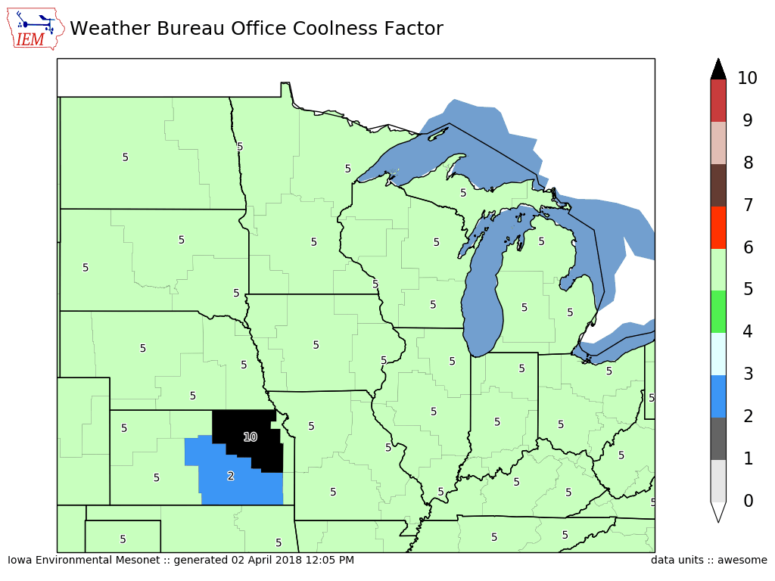
Purpose of my maps is not to show good/bad offices, but show local gradients

Slide 8
Watches & Warnings
Chapter 1

Slide 9
1 Oct 2005 – 29 Mar 2018 NWS Conversion of Watches into Warnings
(double accounting means totals can be over 100%)
4,748 UGC
Blizzard Watches **
Blizzard Warning
78.2%
Winter Storm Warning
12.6%
Wind Chill Warning
10.0%
Wind Chill Advisory
5.1%
No WWA
2.4%
96,559UGC
Winter Storm Watches
Winter Storm Warning
63.8%
Winter Weather Advsiory
35.4%
Blizzard Warning
5.9% (5,671!!)
Snow Advisory
4.0%
No WWA
3.3%
** Blizzard Watch discontinued for 2017-2018 winter season

Slide 10
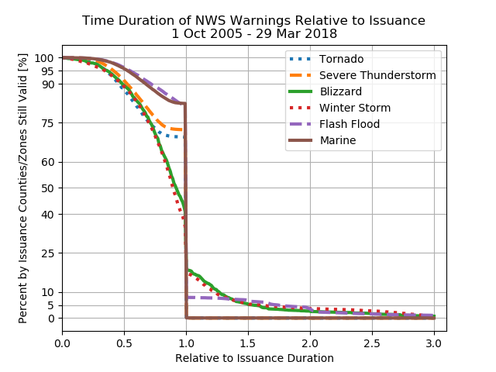

Slide 11
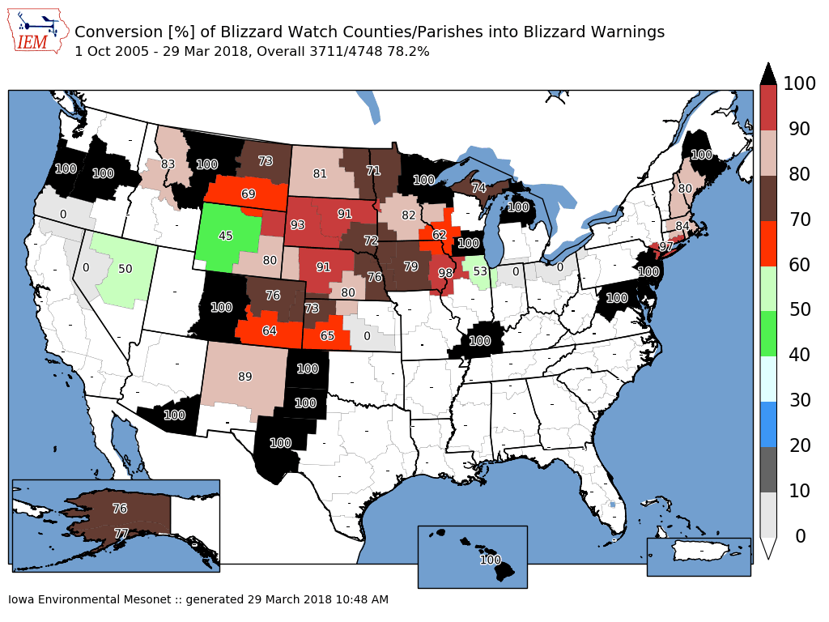

Slide 12
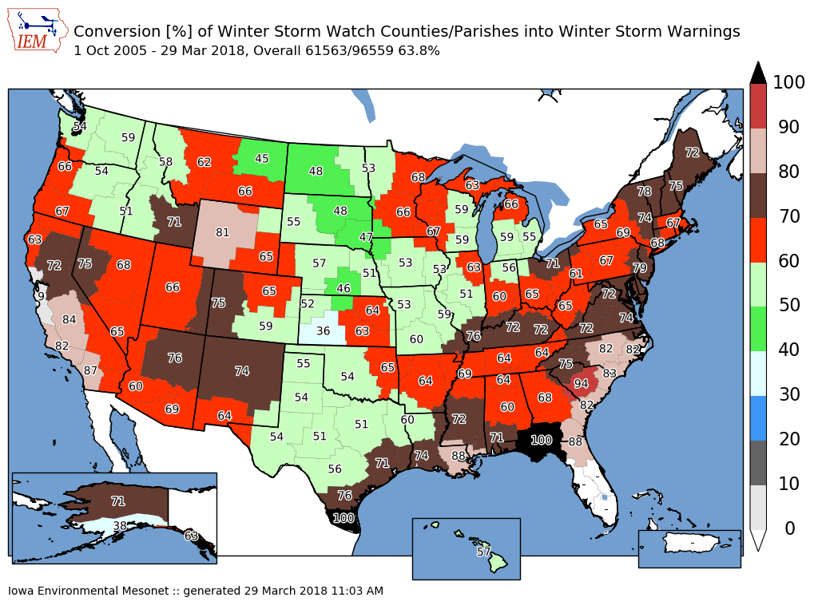

Slide 13
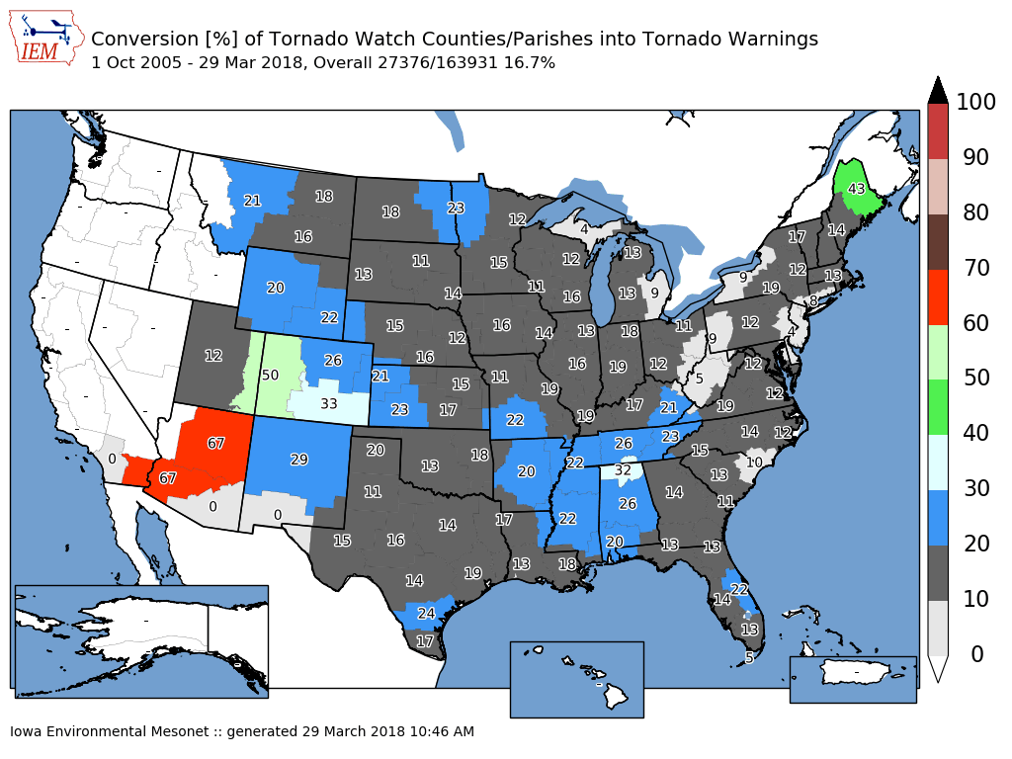

Slide 14
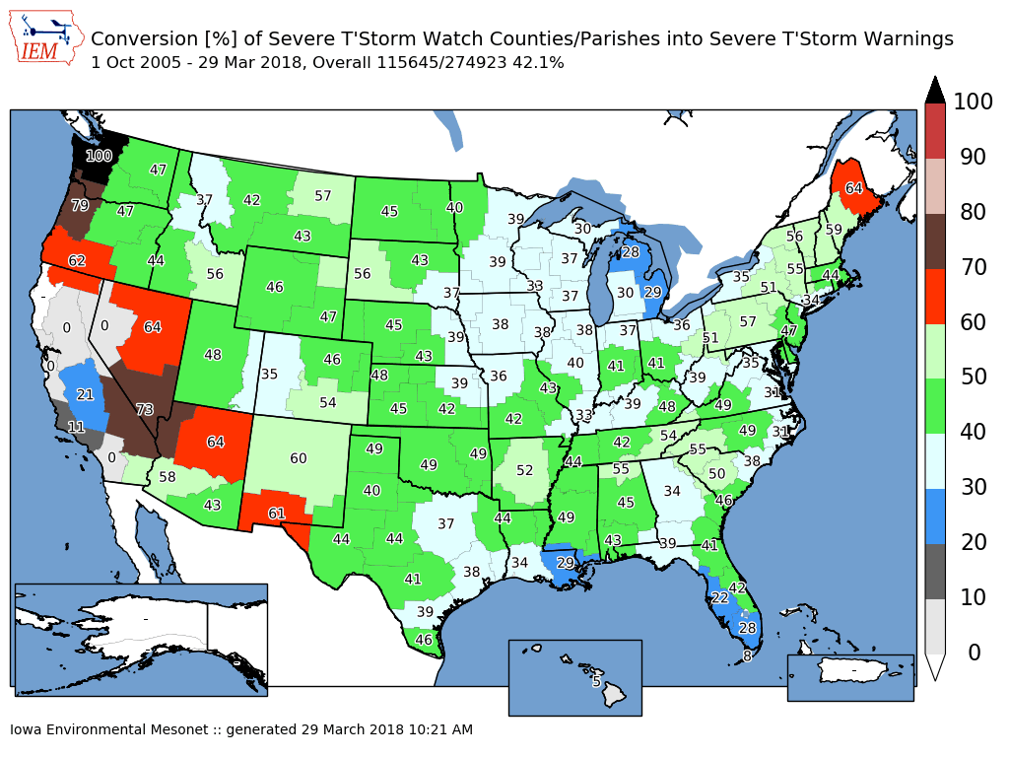

Slide 15
1 Oct 2005 – 29 Mar 2018 NWS Watches before a Warning
(double accounting means totals can be over 100%)
74,501 UGC
Tornado Warnings
Tornado Watch
67.5%
SVR Watch
15.7%
No Watch
16.8%
604,204 UGC
SVR Warnings
SVR Watch
36.3%
Tornado Watch
21.5%
No Watch
42.2%

Slide 16
My standard “Storm based” Warnings ranting
Chapter 2

Slide 17
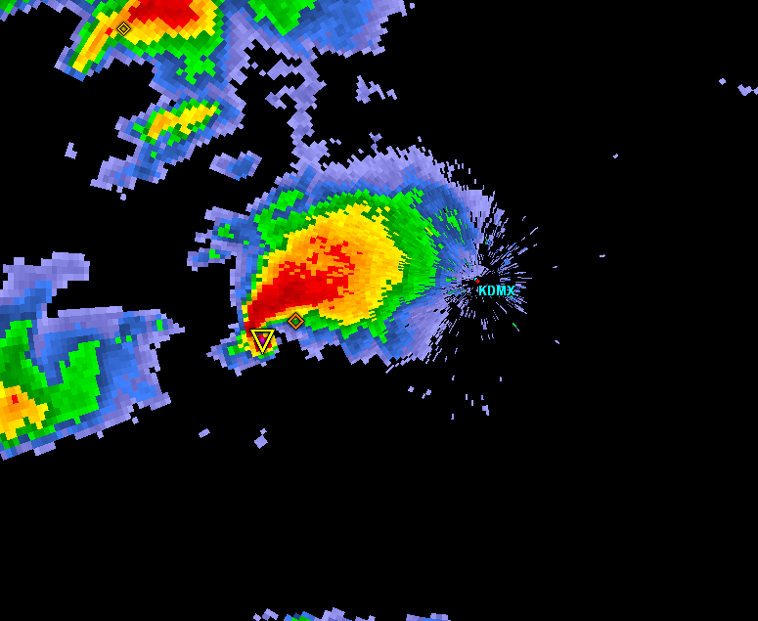
Warning Process Evaluation
Garden Variety Tornado
We had better warn.

Slide 18
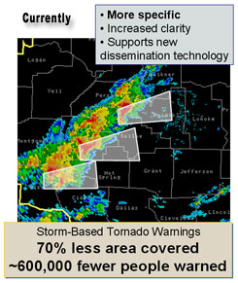
Warning Process Evaluation
Yippee, we can use our fine training and draw a polygon!

Slide 19
Warning Process Evaluation
I draw my fancy pants polygon out for 30 minutes.
I’m done, right?

Slide 20
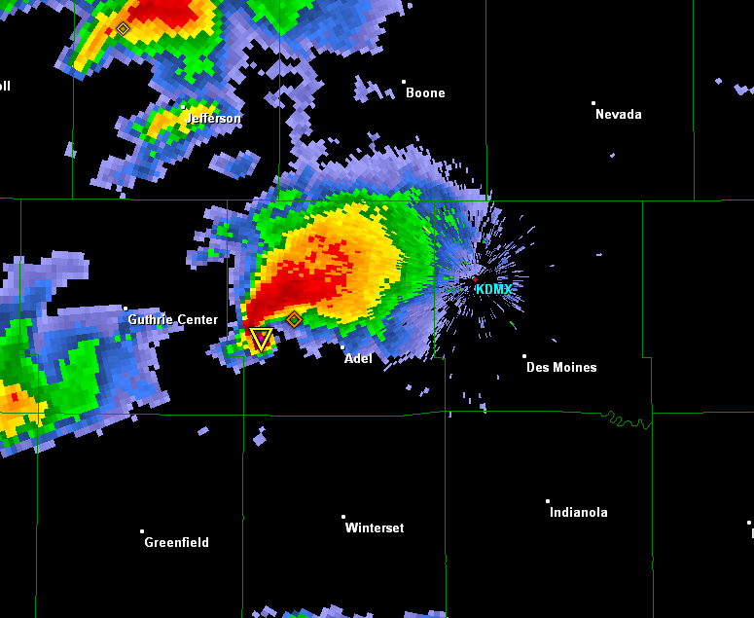
daryl’s here
Warning Process Evaluation
Gasp, I’m warning for 5 counties! Sirens will go off
In all 5!

Slide 21
daryl’s stays asleep
Warning Process Evaluation
WarnGen clipping to the rescue!

Slide 22
Warning Process Evaluation
Whoa, what happened?

Slide 23
Darn it daryl,
I came here for stats (or free food), not altruistic hyperbole.

Slide 24
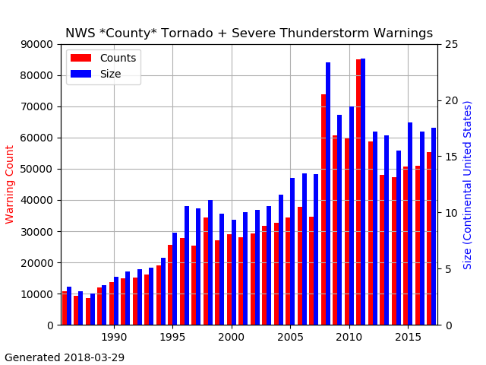
NWS County SVR/TOR Warnings
Storm Based Warnings
NEXRAD

Slide 25
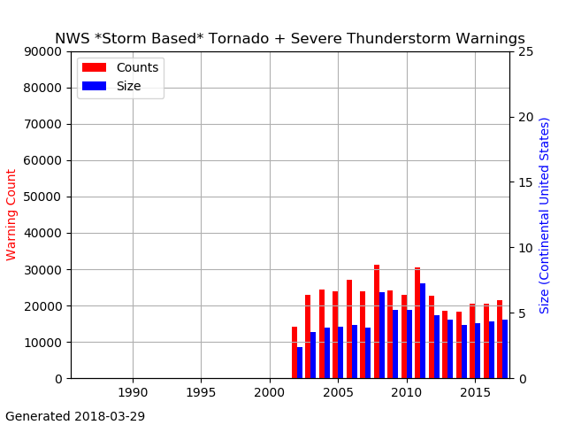
NWS SBW SVR/TOR Warnings

Slide 26
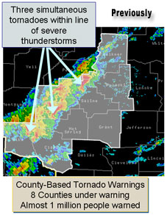
1 Oct 2007, warnings changed
http://www.nws.noaa.gov/sbwarnings/
“Storm-Based Warnings show the specific meteorological or hydrological threat area and are not restricted to geopolitical boundaries.”

Slide 27
But what actually changed?
NWS: Ignore the red, use the yellow
291
WUUS53 KDMX 182302
SVRDMX
IAC007-117-125-135-181-182345-
/O.NEW.KDMX.SV.W.0171.100618T2302Z-100618T2345Z/
BULLETIN - IMMEDIATE BROADCAST REQUESTED
SEVERE THUNDERSTORM WARNING
NATIONAL WEATHER SERVICE DES MOINES IA
602 PM CDT FRI JUN 18 2010
THE NATIONAL WEATHER SERVICE IN DES MOINES HAS ISSUED A
* SEVERE THUNDERSTORM WARNING FOR...
NORTHWESTERN APPANOOSE COUNTY IN SOUTH CENTRAL IOWA...
NORTHEASTERN LUCAS COUNTY IN SOUTH CENTRAL IOWA...
SOUTHWESTERN MARION COUNTY IN SOUTH CENTRAL IOWA...
MONROE COUNTY IN SOUTH CENTRAL IOWA...
SOUTHEASTERN WARREN COUNTY IN SOUTH CENTRAL IOWA...
* UNTIL 645 PM CDT
* AT 600 PM CDT...NATIONAL WEATHER SERVICE DOPPLER RADAR INDICATED A
SEVERE THUNDERSTORM CAPABLE OF PRODUCING GOLF BALL SIZE HAIL...AND
DAMAGING WINDS IN EXCESS OF 60 MPH. THIS STORM WAS LOCATED 10
MILES NORTHEAST OF CHARITON...OR 36 MILES SOUTHEAST OF DES
MOINES...AND MOVING SOUTHEAST AT 30 MPH.
* LOCATIONS IMPACTED INCLUDE...
ALBIA...RUSSELL...MELROSE AND LOVILIA.
PRECAUTIONARY/PREPAREDNESS ACTIONS...
MOVE TO AN INTERIOR ROOM AND STAY AWAY FROM WINDOWS. IF YOU ARE IN A
MOBILE HOME...GET OUT NOW...AND SEEK SHELTER IN A REINFORCED
BUILDING.
A TORNADO WATCH REMAINS IN EFFECT FOR THE WARNED AREA. SEVERE
THUNDERSTORMS CAN PRODUCE TORNADOES WITH LITTLE OR NO WARNING. IF A
TORNADO IS SPOTTED...IMMEDIATELY MOVE TO THE BASEMENT OR SMALL
INTERIOR ROOM OF A REINFORCED BUILDING.
TORRENTIAL RAINFALL IS ALSO OCCURRING WITH THIS STORM...AND MAY LEAD
TO FLASH FLOODING. DO NOT DRIVE YOUR VEHICLE THROUGH FLOODED
ROADWAYS. TURN AROND DON'T DROWN.
&&
LAT...LON 4089 9310 4090 9310 4090 9313 4112 9357
4116 9357 4116 9358 4135 9335 4105 9272
4084 9301
TIME...MOT...LOC 2302Z 300DEG 28KT 4114 9321
WIND...HAIL 60MPH 1.75IN
$$
SMALL

Slide 28


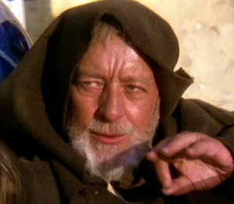
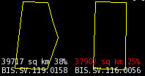
These aren’t the polygons you’re looking for
(Maryland == 26,000 sq km)

Slide 29
Oh daryl, you and your
1% type academic friends always focused on the outliers….
So another altruism:
If less than 50% of warnings are “storm based”, can the program still keep its name?

Slide 30
Quiz Question #1
How do you cancel a portion of the warning?
Answer: Cancel one of the counties in the warning!
IAC181-182341-
/O.CAN.KDMX.SV.W.0171.000000T0000Z-100618T2345Z/
...THE SEVERE THUNDERSTORM WARNING FOR SOUTHEASTERN WARREN COUNTY IS
CANCELLED...
IAC007-117-125-135-182345-
/O.CON.KDMX.SV.W.0171.000000T0000Z-100618T2345Z/
...A SEVERE THUNDERSTORM WARNING REMAINS IN EFFECT FOR SOUTHWESTERN
MARION...MONROE...EASTERN LUCAS AND NORTHWESTERN APPANOOSE COUNTIES
UNTIL 645 PM CDT...

Slide 31
Quiz Question #2
What’s wrong with this picture?

Slide 32
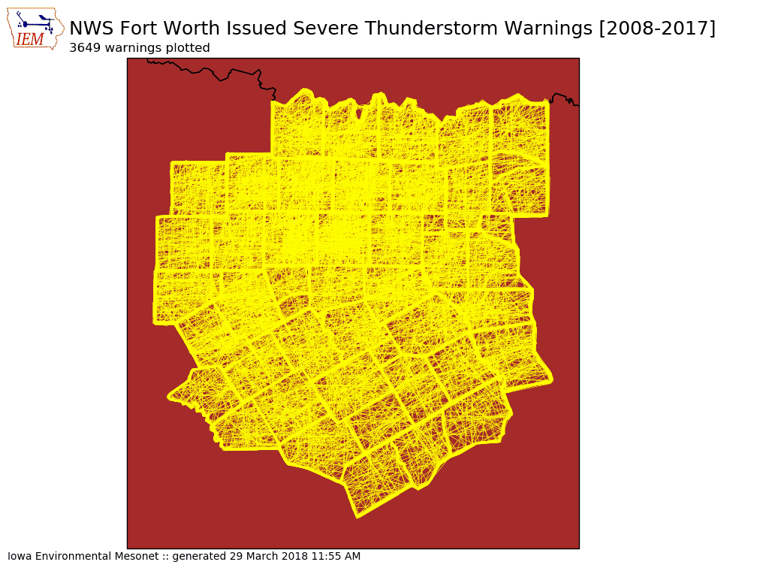

Slide 33


Slide 34

Bah, that is Fort Worth, we are fricken Topeka

Slide 35
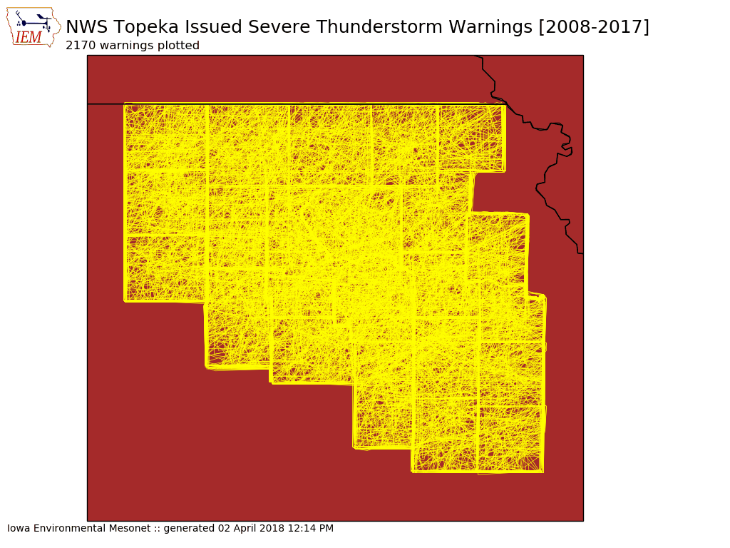

Slide 36


Slide 37
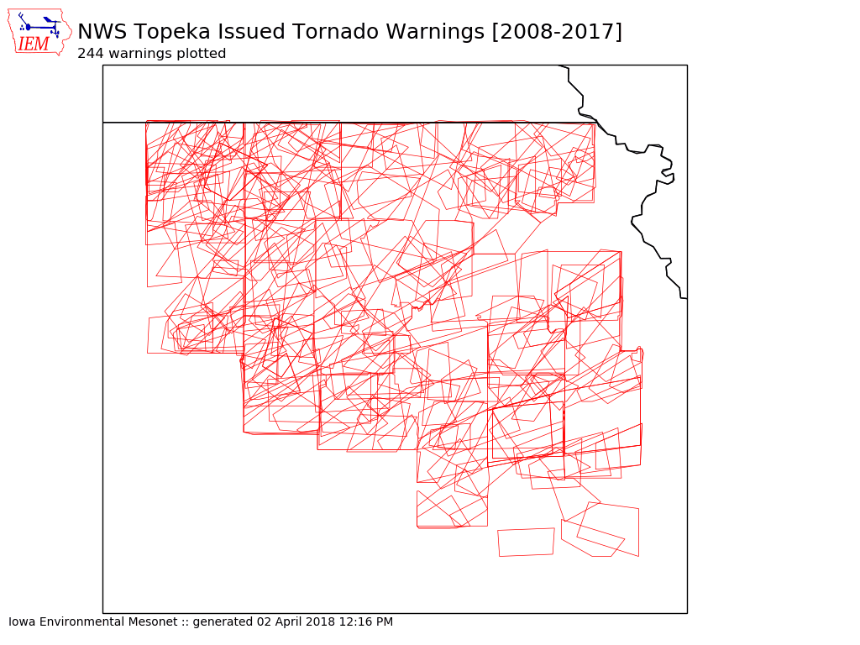

Slide 38
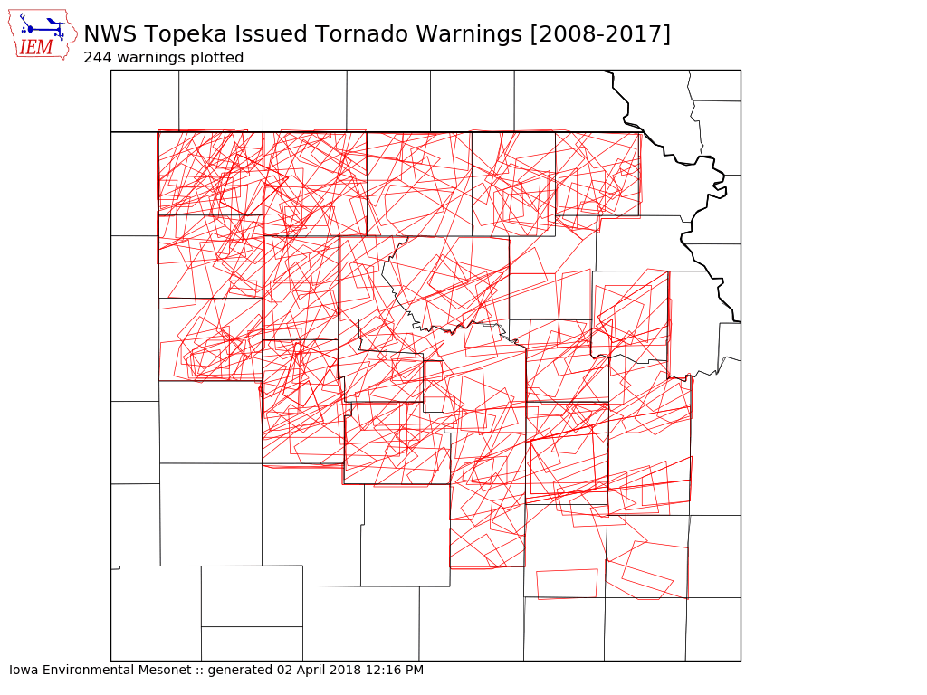

Slide 39
1 Oct 2007 – 23 May 2016:
Number of Polygon Vertices (SVR+TOR)
57.3%
9.5%

Slide 40
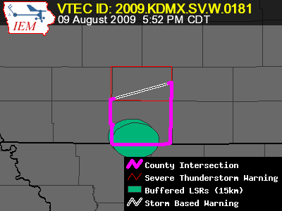
Lets get quantitative
Perimeter Influence
  How much of the polygon perimeter coincides with a political boundary
Size Reduction
  How much smaller was the warning than the counties it was issued against.

Slide 41
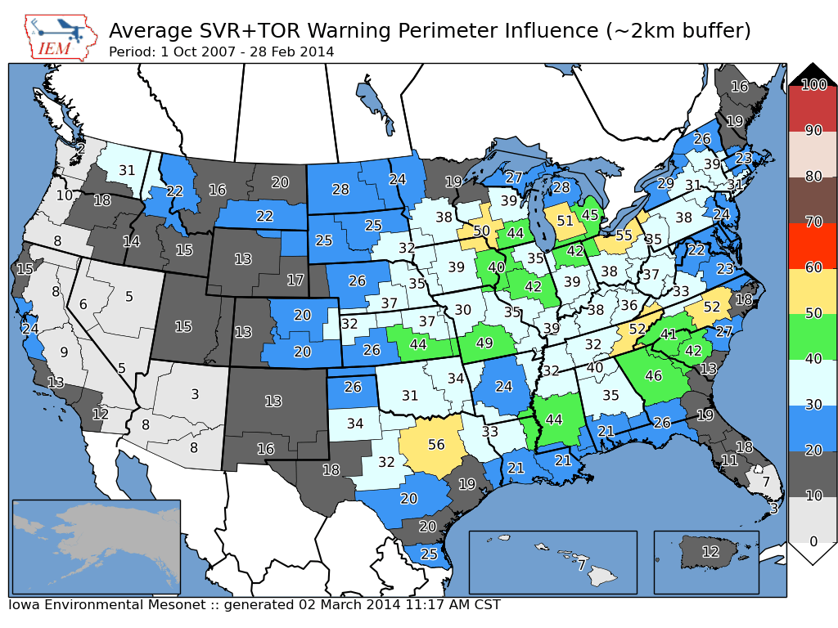

Slide 42
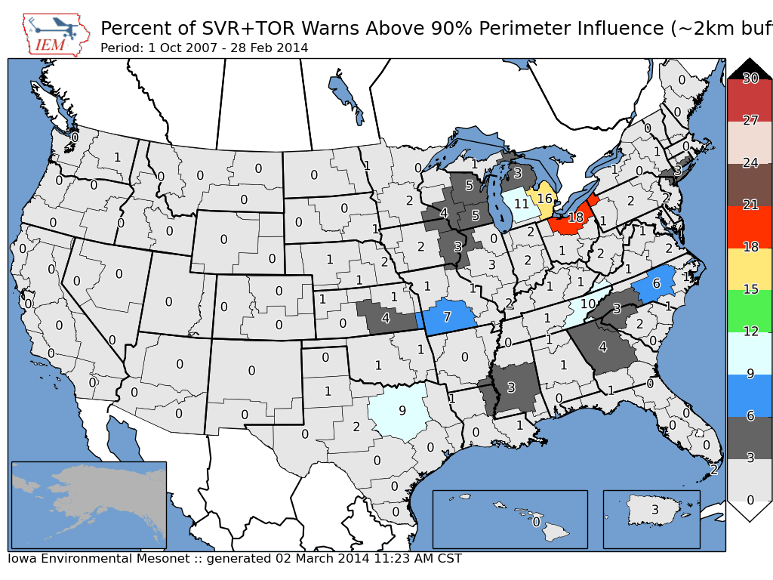
~ 2 % of all warnings

Slide 43
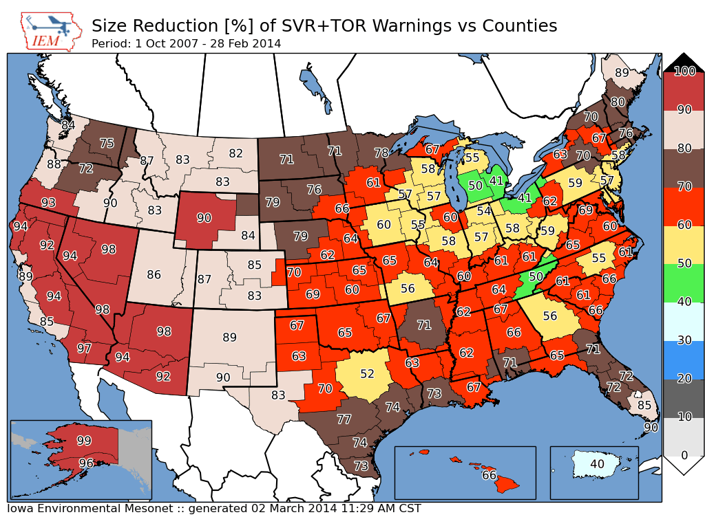
Nationwide Average: 65%

Slide 44
Storm Based Warning size reduction by number of counties in warning

Slide 45
Storm Based Warning # of Counties
0.7% of total

Slide 46
Oh daryl, what about this?
Perimeter ratio is small
So lets compute another metric for the number of polygon vertices within 2km of a political border
County
Warning

Slide 47
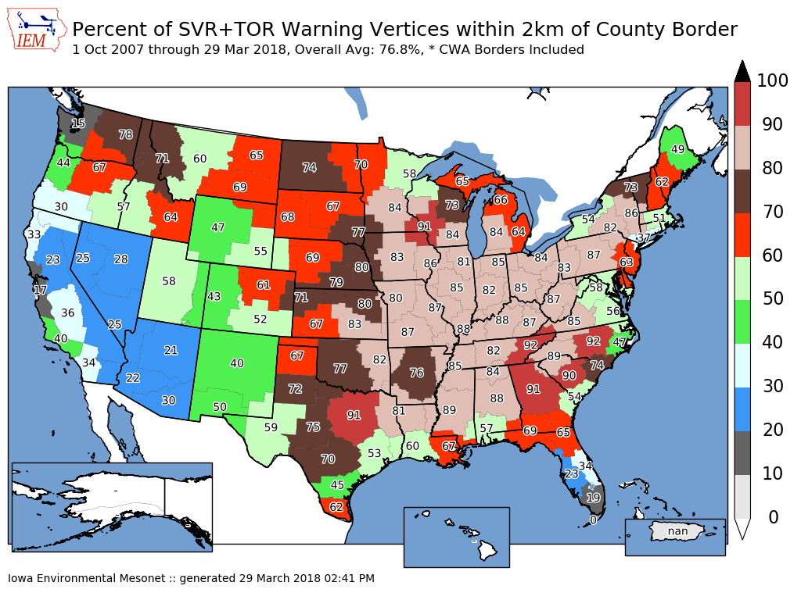
Overall Average: 75%
Overall: 77%

Slide 48
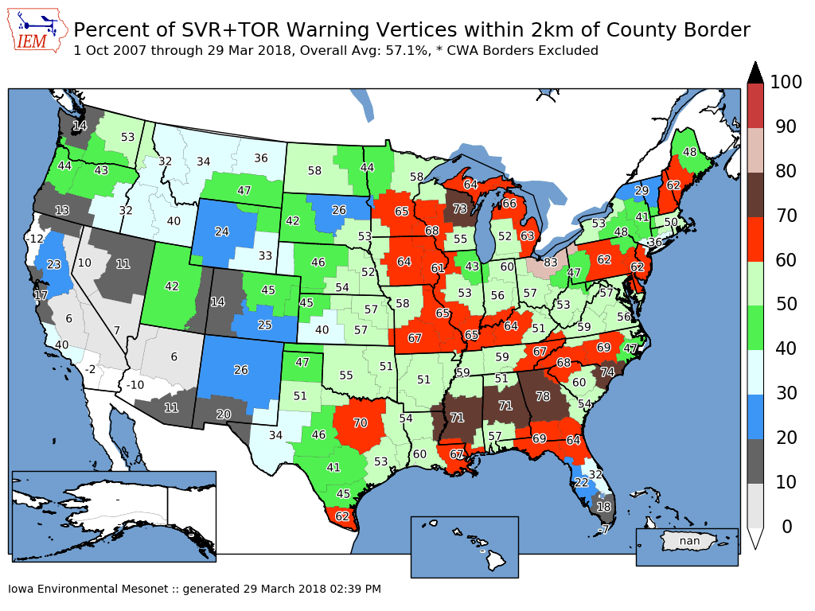
Overall Average: 75%
Overall: 57%

Slide 49
Academic Thought Experiment
Take TIME..MOT.LOC and draw my own warning:
30 min duration
~10 km left
~10 and increase to 30 km to the right
Which will #win ?

Slide 50
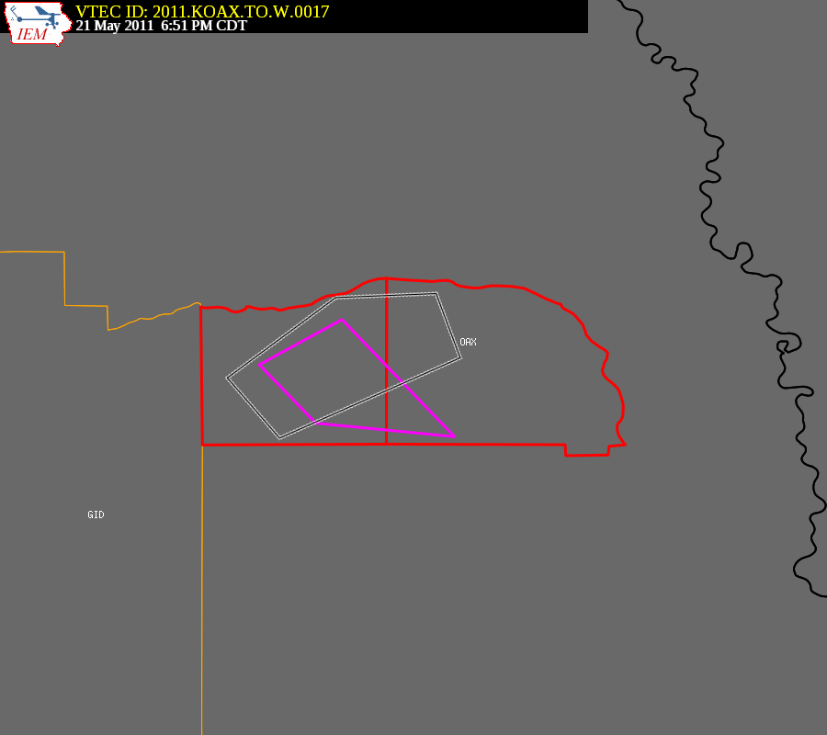
Purple box is the warning from
the automated algorithm

Slide 51
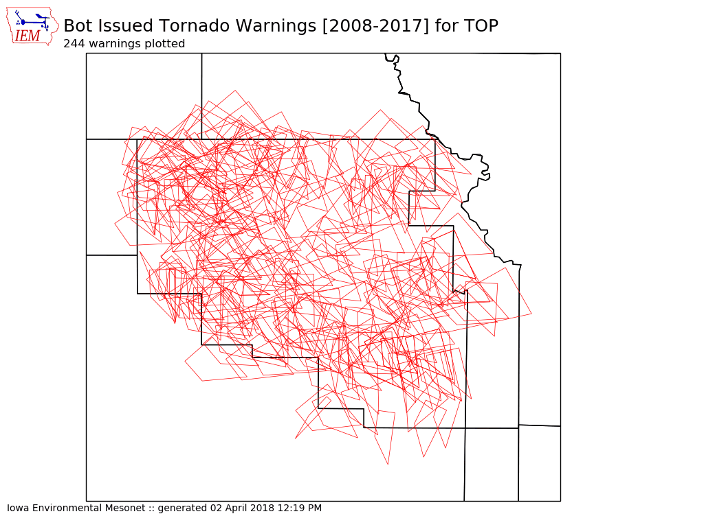

Slide 52

TOP’s TORs 2008-2017
(based on LSR data)
 | WEATHER BUREAU | ACADEMIA
Average Size (sq km) | 680 | 773
Areal Verification (15km) | 23% | 18.5%
Vertex County Intersection | 71% (51% non CWA) | 28% (24% non CWA)
Size Reduction | 78.7 % | Didn’t Compute n/a
Perimeter Ratio | 29.9% | 25.7%
Probability of Detection | 0.79 | 0.66
False Alarm Rate | 0.61 | 0.67
Critical Success Index | 0.35 | 0.27
Did the weather
bureau #win?

Slide 53
Chapter 2 Summary
~ 25% of TOR/SVR Warnings are 4 sided
Only ~ 2 % of all SVR/TOR warnings are pure county retracements
~ 75% of polygon vertices are guided by county borders
SBWs have cut the size of warnings by over 60%, but the number of county based warnings has increased.

Slide 54
Apps & Archives
Chapter 3

Slide 55
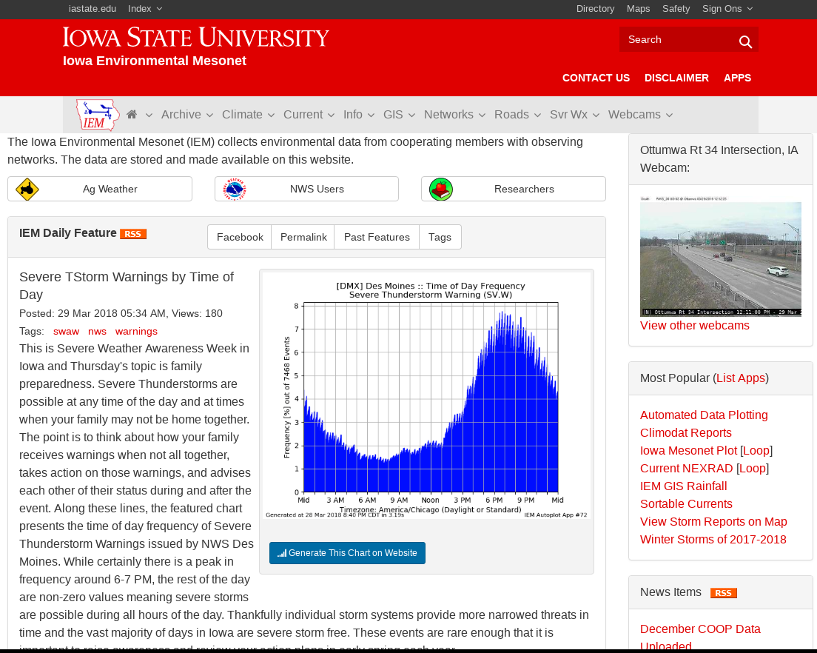

Slide 56
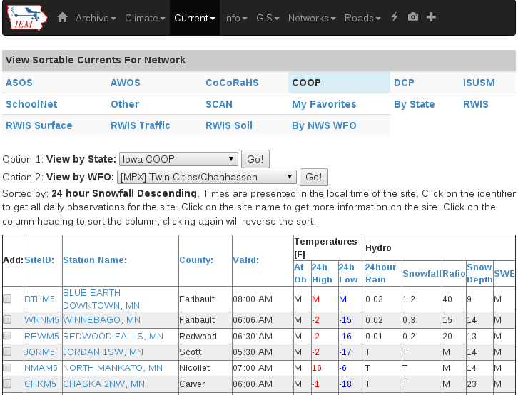
COOP Reports by WFO
Realtime processing of SHEF data
Sortable columns
SWE reports are included
Snow/Precip ratio is computed for QC help
Click on NWSLI to get all reports for the year
(Discuss DCP vs COOP)

Slide 57
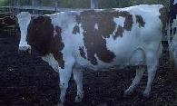
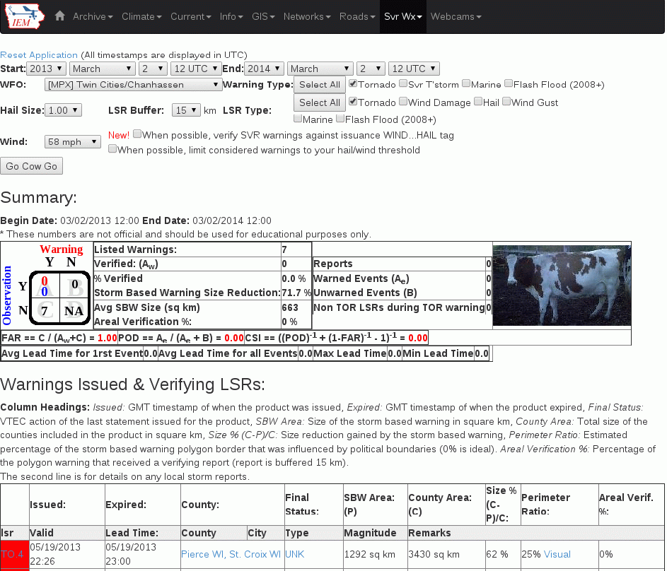
IEM Cow
SBW Verification based on Local Storm Reports, not Storm Data
Provides geometry stats on polygon
Handy way to review event data
It is ‘live’ and accurate at the time of page load

Slide 58
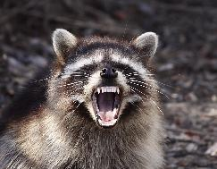
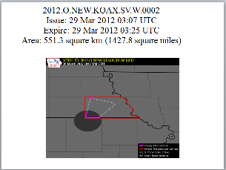
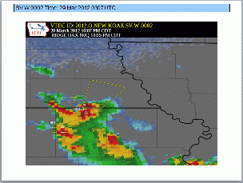
IEM Raccoon
OAX’s Dan Nietfeld gave me the idea
Create simple and quick Powerpoints of SVR,TOR warning events
Intended use:
  Internal Office review of events
  Quick materials for presentations

Slide 59
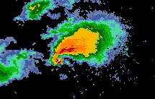
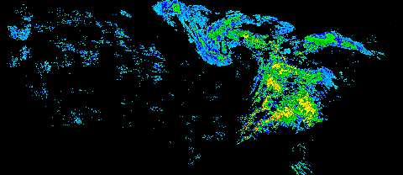
NEXRAD Archives
1km composite every 5 minutes back to 1995
Single site imagery since 1 Jan 2012
Iowa NEXRADs are backfilled.
TWX is backfilled to 1994!
GIS Ready!

Slide 60
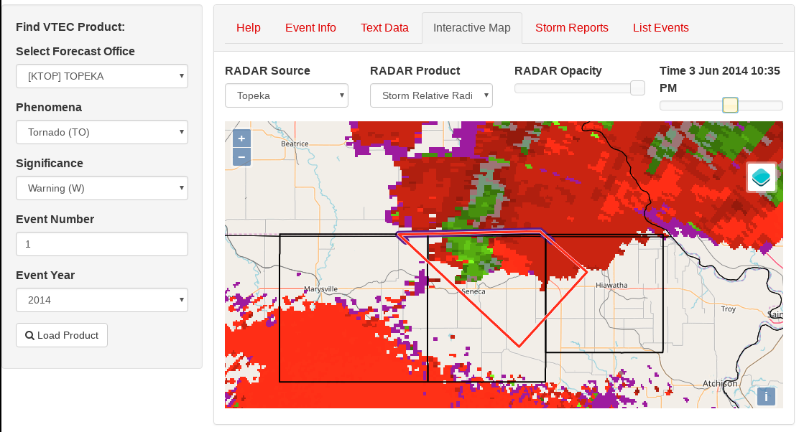
VTEC Browser

Slide 61
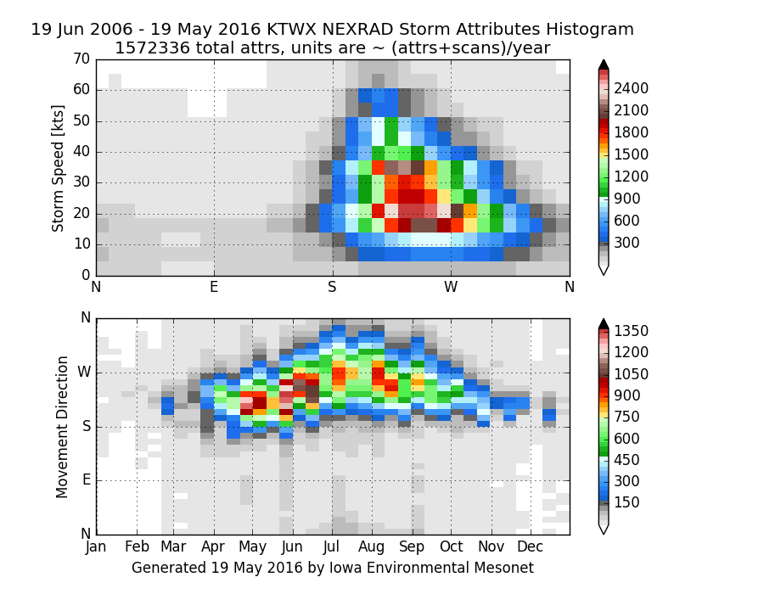
NEXRAD Storm Attribute Archive

Slide 62
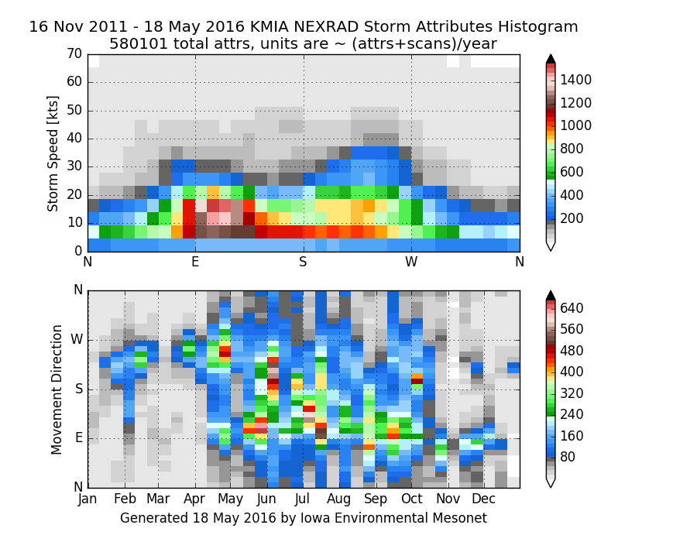
Fun Comparison, Here’s Miami KAMX

Slide 63
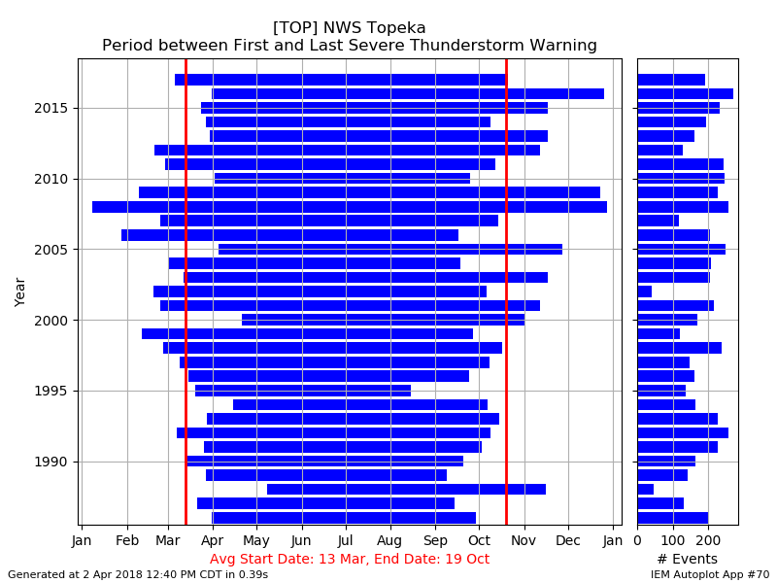
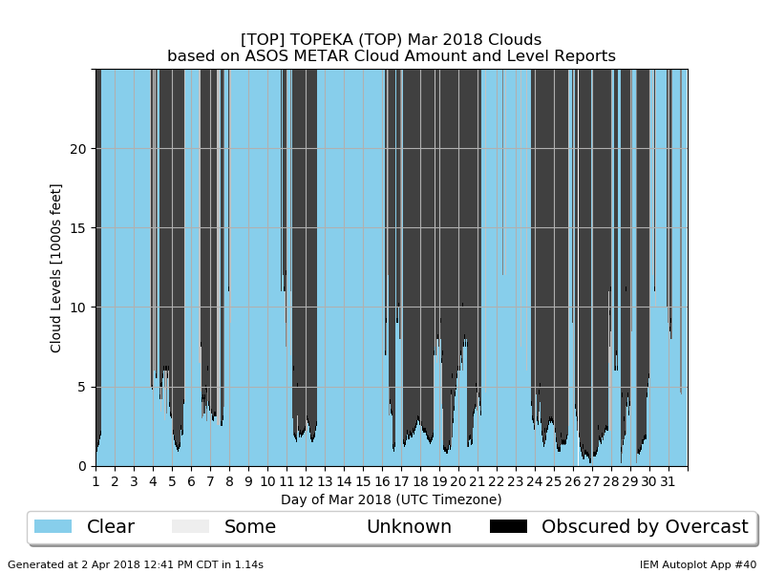
“Autoplot” application
~200 Plot Types
Almost all work for Nebraska Data

Slide 64
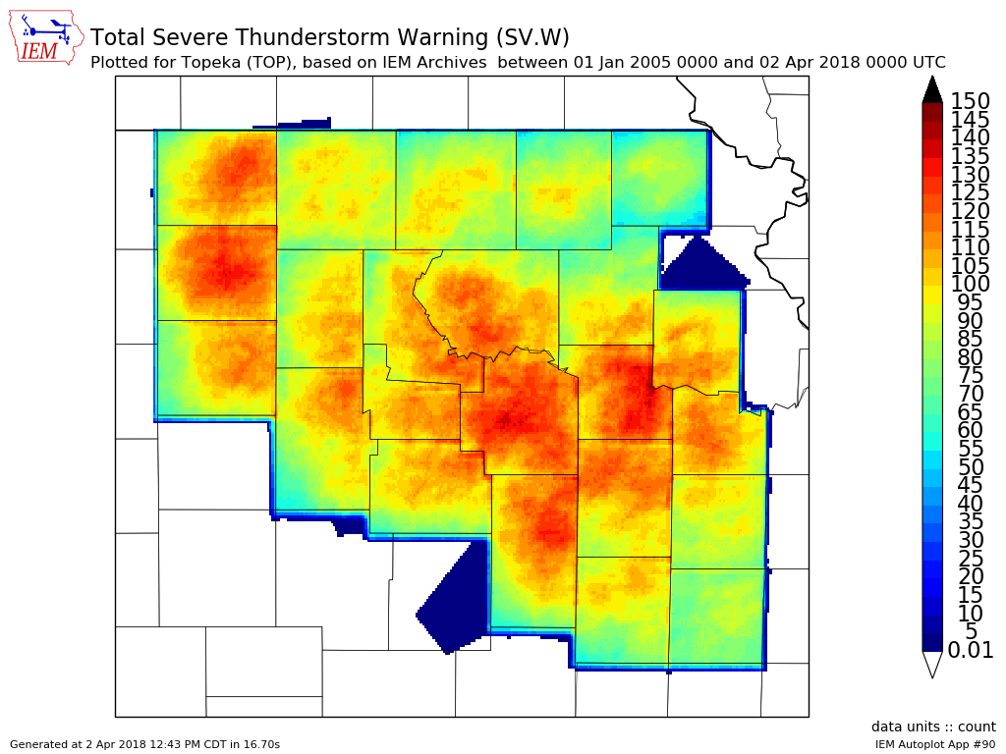
Autoplot #90

Slide 65
Other Archives of Interest
App to quickly view text products by center by date or range of dates (back to 2001, working on going back to 1996)
Processed SHEF archive back to 2010
Shapefile download of VTEC warnings and Local Storm Reports
Nearly complete archive of ASOS/AWOS processed data and raw METARs, now including MADIS HFMETAR
Downloadable (atomic data) MOS archive since 2007
Search VTEC Archive / SPC Outlooks by Zone or by Point
Archived NWS WWA Map since 9 Apr 2013
View METAR reports within NPW-type products
Map/Table summarizing data within Daily Climate Summary (CLI)
Hopefully NCDC NCEI puts me out
of (my misery / business) someday!

Slide 66

Time for Questions?
mesonet.agron.iastate.edu
Daryl Herzmann
515.294.5978
akrherz@iastate.edu

